Slide 1
Welcome to
Our Sunday School
We’ll start at 9:07
visit OurSundaySchool.com for more about our class

Slide 2
Ephesians, week 7 (pages 46–51)

Slide 3
Insert video here

Slide 5
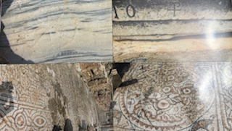

Slide 6
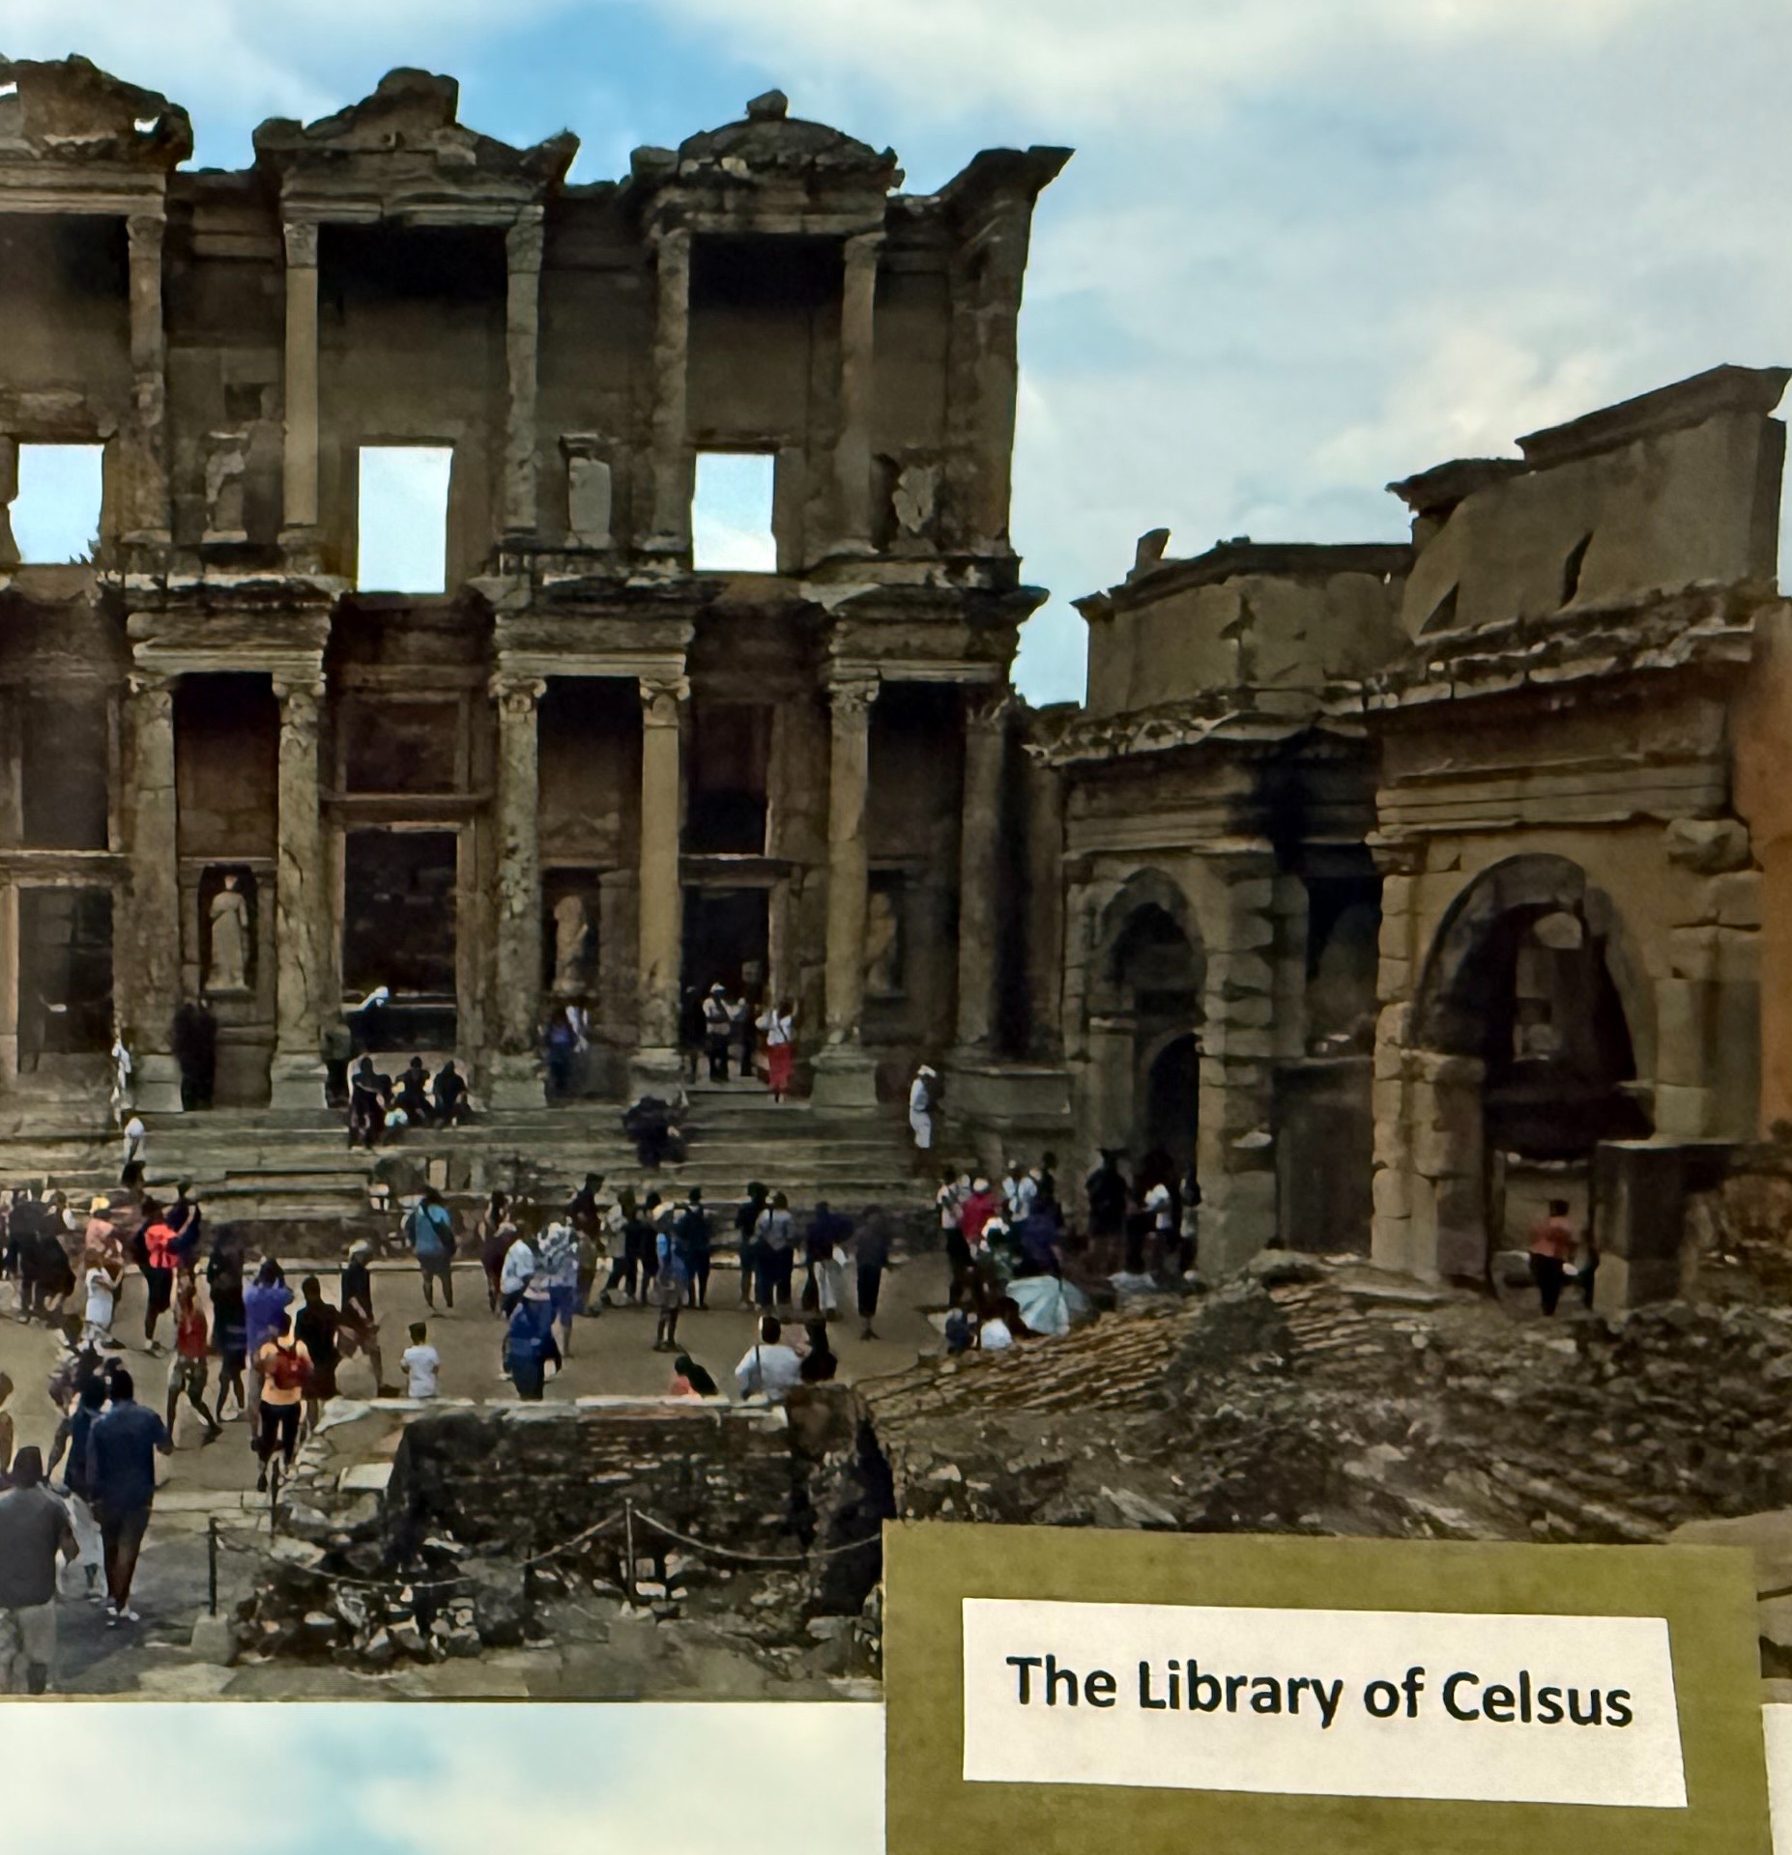

Slide 7
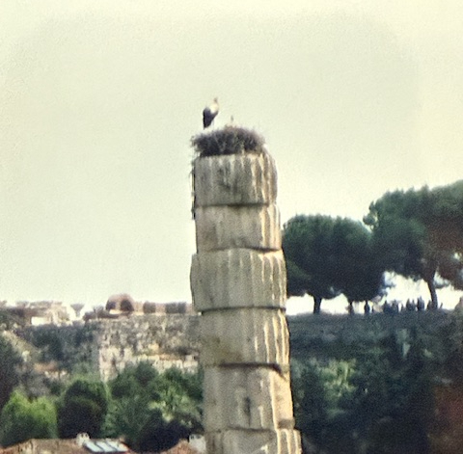
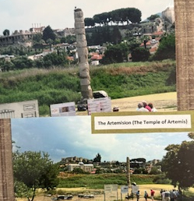

Slide 8
Dr. Rick Warren
God is love. He didn’t need us, He wanted us. And that is the most amazing thing.

Slide 9
Ephesians 1:11–12
In Him, we also have been made an inheritance, having been predestined according to the purpose of Him who works all things according to the counsel of His will, to the end that we who first have hoped in Christ would be to the praise of His glory.

Slide 10
Dr. Max Anders
This inheritance is not an accident or a whim. It is keeping with God’s plan for us from the beginning.

Slide 11
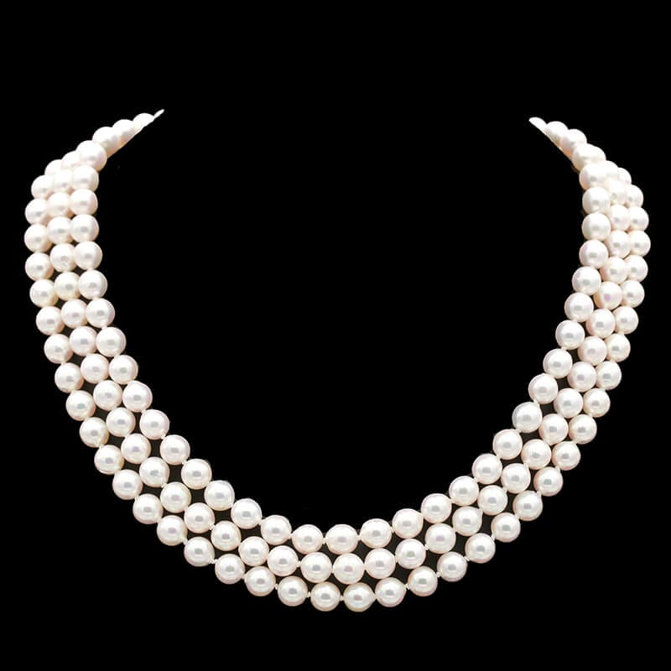

Slide 12
Dr. Bryan Chapell
Paul wants everyone to remember that we are loved not because of what is in us but because of what is in God.

Slide 13
Next time (dv): Ephesians 1:13–14 (pp. 51–57)

Slide 14
Commentaries
Quotes are due to Jim by Thursday night
If you would like one, let Jim know

Slide 15
Prayer time
Write down your prayer requests (on the Weekly Update or in the comments)
Lean in, engage, and pray for someone not with you
Be out of this room by 9:50
Go worship

